Slide 1
UNIT_IV

Slide 2
 Cyber security: Organizational Implications
In the global environment with continuous network connectivity, the possibilities for cyber attacks can emanate from sources that are local, remote, domestic or foreign.
They could be launched by an individual or a group. They could be casual probes from hackers using personal computers (PCs) in their homes, hand-held devices or intense scans from criminal groups.

Slide 3
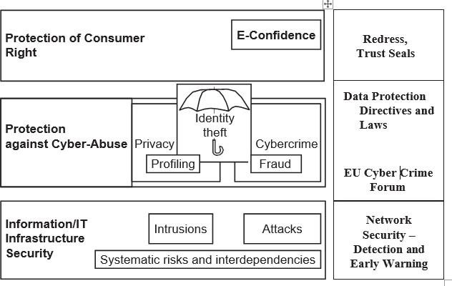
Fig: A cyber security perspective. EU is the European Union.

Slide 4
PI is information that is, or can be, about or related to an identifiable individual. It includes any information that can be linked to an individual or used to directly or indirectly identify an individual.
Most information the organization collects about an individual is likely to come under “PI” category if it can be attributed to an individual. For an example, PI is an individual’s ﬁrst name or ﬁrst initial and last name in combination with any of the following data:
Social security number (SSN)/social insurance number.
Driver’s license number or identiﬁcation card number.
Bank account number, credit or debit card number with personal identiﬁcation number such as an access code, security codes or password that would permit access to an individual’s ﬁnancial account.
Home address or E-Mail address.
Medical or health information.

Slide 5
An insider threat is defined as “the misuse or destruction of sensitive or confidential information, as well as IT equipment that houses this data by employees, contractors and other ‘trusted’ individuals.”
Insider threats are caused by human actions such as mistakes, negligence, reckless behavior, theft, fraud and even sabotage.
There are three types of “insiders” such as:
A malicious insider is motivated to adversely impact an organization through a range of actions that compromise information conﬁdentiality, integrity and/or availability.
A careless insider can bring about a data compromise not by any bad intention but simply by being careless due to an accident, mistake or plain negligence.
A tricked insider is a person who is “tricked” into or led to providing sensitive or private company data by people who are not truthful about their identity or purpose via “pretexting” (known as social engineering).

Slide 6
Insider Attack Example 1: Heartland Payment System Fraud
A case in point is the infamous “Heartland Payment System Fraud” that was uncovered in January 2010
In this case, the concerned organization suﬀered a serious blow through nearly 100 million credit cards compromised from at least 650 ﬁnancial services companies. When a card is used to make a purchase, the card information is transmitted through a payment network. The info on card magnetic stripe is stolen by attackers/

Slide 7
Insider Attack Example 2: Blue Shield Blue Cross (BCBS)
Yet another incidence is the Blue Cross Blue Shield (BCBS) Data Breach in October 2009 the theft of 57 hard drives from a BlueCross BlueShield of Tennessee training facility puts the private information of approximately 500,000 customers at risk in at least 32 states.
The two lessons to be learnt from this are:
Physical security is very important.
Insider threats cannot be ignored.

Slide 8
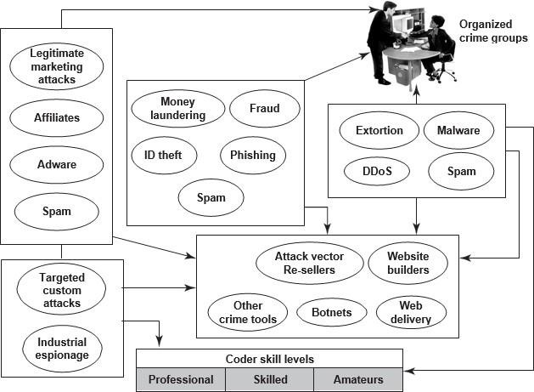
Fig: Cybercrimes – the flow and connections.

Slide 9
Cybercrimes take place due to weakness of cybersecurity practices and “privacy” which may get impacted when cybercrimes happen.
Privacy has following four key dimensions:
Informational/data privacy: It is about data protection, and the users’ rights to determine how, when and to what extent information about them is communicated to other parties.
Personal privacy: It is about content ﬁltering and other mechanisms to ensure that the end-users are not exposed to whatever violates their moral senses.
Communication privacy: This is as in networks, where encryption of data being transmitted is important.
Territorial privacy: It is about protecting users’ property for example, the user devices from being invaded by undesired content such as SMS or E-Mail/Spam messages.

Slide 10
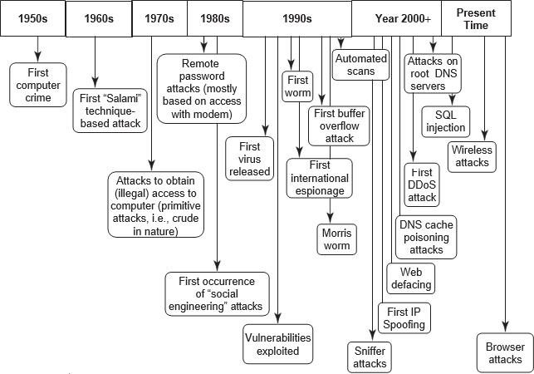
Fig: Security threats – paradigm shift.

Slide 11
The key challenges from emerging new information threats to organizations are as follows:
Industrial espionage: There are several tools available for web administrators to monitor and track the various pages and objects that are accessed on their website
.
IP-based blocking: This process is often used for blocking the access of speciﬁc IP addresses and/or domain names.
IP-based “cloaking”: Businesses are global in nature and economies are interconnected.
Cyberterrorism: “Cyberterrorism” refers to the direct intervention of a threat source toward your organization’s website.
Conﬁdential information leakage: “Insider attacks” are the worst ones. Typically, an organization is protected from external threats by your ﬁrewall and antivirus solutions

Slide 12
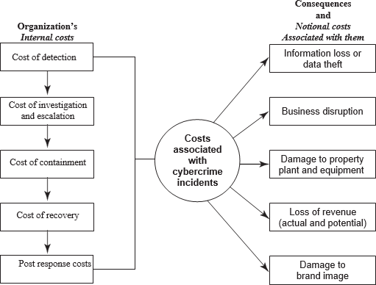
Cost of Cybercrimes and IPR Issues: Lessons for Organizations.

Slide 13
Organizations have Internal Costs Associated with Cyber security Incidents
The internal costs typically involve people costs, overhead costs and productivity losses. The internal costs, in order from largest to the lowest and that has been supported by the benchmark study mentioned:
Detection costs.(25%-Largest)
Recovery costs.(21%)
Post response costs.(19%)
Investigation costs.(14%)
Costs of escalation and incident management.(12%)
Cost of containment.(9%-Lower)

Slide 14
The consequences of cybercrimes and their associated costs, mentioned
Information loss/data theft.(Highest-42%)
Business disruption.(22%)
Damages to equipment, plant and property.(13%)
Loss of revenue and brand tarnishing.(13%)
Other costs.(10%)

Slide 15
Percentage of Organizations impacted by various types of cyber crimes
1.Viruses,worms and Trojans(100%)
2.Malware(80%)
3.Botnets(73%)
4.Web-Based Attacks(53%)
5.Phishing and Social Engineering(47%)
6.Stolen devices(36%)
7.Malicious insiders(29%)
8.Malicious Code(27%)

Slide 16
AVG days taken to Resolve Cyber attacks
1.Attacks by Malicious Insiders(42days-Highest)
2.Malicious code(39days)
3.Webbased Attacks(19days)
4.Data loss due to stolen devices(10days)
5.Phishing and social engineering attacks(9days)
6.Viruses,worms and Trojans(2.5 days)
7.Malware(2days)
8.Botnets(2days)

Slide 17
There are many new endpoints in today’s complex networks; they include hand-held devices.
Endpoint protection: It is an often-ignored area but it is IP-based printers, although they are passive devices, are also one of the endpoints.
Secure coding: These practices are important because they are a good mitigation control to protect organizations from “Malicious Code” inside business applications.
HR checks: These are important prior to employment as well as after employment.
Access controls: These are always important, for example, shared IDs and shared laptops are dangerous.
Importance of security governance: It cannot be ignored policies, procedures and their eﬀective implementation cannot be over-emphasized.

Slide 18
Organizational Implications of Software Piracy
Use of pirated software is a major risk area for organizations.
From a legal standpoint, software piracy is an IPR violation crime. Use of pirated software increases serious threats and risks of cybercrime and computer security when it comes to legal liability.
The most often quoted reasons by employees, for use of pirated software, are as follows:
Pirated software is cheaper and more readily available.
Many others use pirated software anyways.
Latest versions are available faster when pirated software is used.

Slide 19
Web Threats for Organizations: The Evils and Perils
Overview of Web Threats to Organizations
The Internet has engulfed us! Large number of companies as well as individuals have a connection to the Internet. Employees expect to have Internet access at work just like they do at home.
IT managers must also find a balance between allowing reasonable personal Internet use at work and maintaining office work productivity and work concentration in the office.

Slide 20
Employee Time Wasted on Internet Surfing
This is a very sensitive topic indeed, especially in organizations that claim to have a “liberal culture.” Some managers believe that it is crucial in today’s business world to have the ﬁnger on the pulse of your employees.
People seem to spend approximately 45-60 minutes each working day on personal web surfing at work.

Slide 21
Enforcing Policy Usage in the Organization
An organization has various types of policies. A security policy is a statement produced by the senior management of an organization, or by a selected policy board or committee to dictate what type of role security plays within the organization.

Slide 22
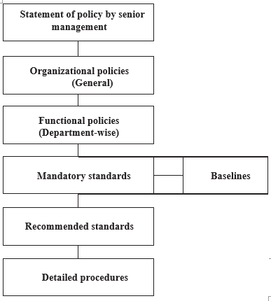

Slide 23
Monitoring and Controlling Employees’ Internet Surfing
A powerful deterrent can be created through effective monitoring and reporting of employees’ Internet surfing.
Even organizations with restrictive policies can justify a degree of relaxation; for example, allowing employees to access personal sites only during the lunch hour or during speciﬁed hours.
Keeping Security Patches and Virus Signatures Up to Date
Updating security patches and virus signatures have now become a reality of life, a necessary activity for safety in the cyberworld! Keeping security systems up to date with security signatures, software patches, etc. is almost a nightmare for management.

Slide 24
Surviving in the Era of Legal Risks
As website galore, most organizations get worried about employees visiting inappropriate or oﬀensive websites. We mentioned about Children’s Online Privacy Protection.
Serious legal liabilities arise for businesses from employee’s misuse/inappropriate use of the Internet.
Bandwidth Wastage Issues
Today’s applications are bandwidth hungry; there is an increasing image content in messages and that too, involving transmission of high-resolution images.
There are tools to protect organization’s bandwidth by stopping unwanted traffic before it even reaches your Internet connection.
Mobile Workers Pose Security Challenges
Use of mobile handset devices in cybercrimes. Most mobile communication devices for example, the personal digital assistant

Slide 25
Challenges in Controlling Access to Web Applications
Today, a large number of organizations’ applications are web based. There will be more in the future as the Internet oﬀers a wide range of online applications, from webmail or through social networking to sophisticated business applications.
The Bane of Malware
Many websites contain malware. Such websites are a growing security threat. Although most organizations are doing a good job of blocking sites declared dangerous, cyber attackers, too, are learning. Criminals change their techniques rapidly to avoid detection.
The Need for Protecting Multiple Offices and Locations
Delivery from multi-locations and teams collaborating from multi-locations to deliver a single project are a common working scenario today. Most large organizations have several oﬃces at multiple locations.

Slide 26
Social Media Marketing: Security Risks and Perils for Organizations
Social media marketing has become dominant in the industry.
According to fall 2009 survey by marketing professionals, usage of social media sites by large business-to-business (B2B) organizations shows the following:
Facebook is used by 37% of the organizations.
LinkedIn is used by 36% of the organizations.
Twitter is used by 36% of the organizations.
YouTube is used by 22% of the organizations.
My Space is used by 6% of the organizations.

Slide 27
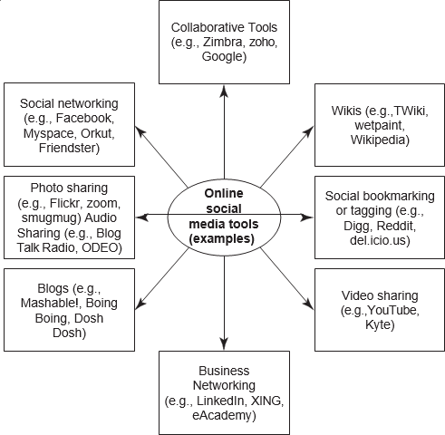

Slide 28
Understanding Social Media Marketing
Most professionals today use social technologies for business purposes. Most common usage include: marketing, internal collaboration and learning, customer service and support, sales, human resources, strategic planning, product development.
Following are the most typical reasons why organizations use social media marketing to promote their products and services:
To be able to reach to a larger target audience in a more spontaneous and instantaneous manner without paying large advertising fees.
To increase traﬃc to their website coming from other social media websites by using Blogs and social and business-networking. Companies believe that this, in turn, may increase their “page rank” resulting in increased traﬃc from leading search engines.
To reap other potential revenue beneﬁts and to minimize advertising costs because social media complements other marketing strategies such as a paid advertising campaign.
To build credibility by participating in relevant product promotion forums and responding to potential customers’ questions immediately.
To collect potential customer proﬁles. Social media sites have information such as user proﬁle data, which can be used to target a speciﬁc set of users for advertising

Slide 29
There are other tools too that organizations use; industry practices indicate the following:
Twitter is used with higher priority to reach out to maximum marketers in the technology space and monitor the space.
Professional networking tool LinkedIn is used to connect with and create a community of top executives from the Fortune 500.
Facebook as the social group or social community tool is used to drive more traﬃc to Websense website and increase awareness about Websense.
YouTube (the video capability tool to run demonstrations of products/services, etc.) is used to increase the brand awareness and create a presence for corporate videos.
Wikipedia is also used for brand building and driving traﬃc.

Slide 30
Security and Privacy Implications from Cloud Computing
There are data privacy risks associated with cloud computing. Basically, putting data in the cloud may impact privacy rights, obligations and status. There is much legal uncertainty about privacy rights in the cloud. Organizations should think about the privacy scenarios in terms of “user spheres.”
There are three kinds of spheres and their characteristics are as follows:
User sphere: Here data is stored on users’ desktops, PCs, laptops, mobile phones, Radio Frequency Identification (RFID) chips, etc. Organization’s responsibility is to provide access to users and monitor that access to ensure misuse does not happen.
Recipient sphere: Here, data lies with recipients: servers and databases of network providers, service providers or other parties with whom data recipient shares data.
Joint sphere: Here data lies with web service provider’s servers and databases. This is the in between sphere where it is not clear to whom does the data belong

Slide 31
Protecting People’s Privacy in the Organization
The costs associated with cybercrimes. A key point in that discussion is that people perceive their PI/SPI to be very sensitive.
From privacy perspective, people would hate to be monitored in terms of what they are doing, where they are moving.
In the US, Social Security Number is a well-established system/mechanism for uniquely identifying all American citizens; however, similar thoughts are now emerging in India.
The UID Project was started by Government of India and is running through an agency called Unique Identiﬁcation Authority of India (UIDAI) based on the similar concept.

Slide 32
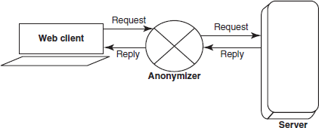
Fig: Anonymity by web proxy.

Slide 33
Forensics Best Practices for Organizations
This section focuses on forensics readiness of organizations. Organization’s forensics readiness is important forensics readiness is defined as the ability of an organization to maximize its potential to use digital evidence while minimizing the costs of an investigation.
Preparation to use digital evidence is not easy – it involves system and staﬀ monitoring, technical, physical and procedural means to secure data to evidential standards of admissibility, processes and procedures.
All this becomes essential for ensuring that staﬀ recognizes the importance and legal sensitivities of evidence, and appropriate legal advice and interfacing with law enforcement.

Slide 34
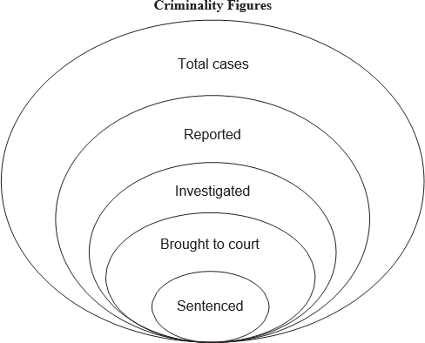
Fig: Cyber forensics and case investigation: Where it ends.

Slide 35
Organizations must Understand Digital Forensics Investigation and Digital Evidences
Organizations must appreciate that the quality and availability of evidence is a passive aspect of the DFI.
Cybercriminals are known to exploit the fact that investigation is costly and takes time.
The categories of guiding procedures and activities that facilitate DFI are as follows:
Retaining information;
Planning the response;
Training;
Accelerating the investigation;
Preventing anonymous activities;
Protecting the evidence.

Slide 36
Concerns with Being a Forensically Ready Organization
An eﬀective incident response system is pertinent to an organization’s forensics readiness this is because digital evidence is required whenever it can be used to support a legal process.
Key Activities for Organizations Getting Forensically Ready
In the context of forensic readiness discussion, the key activities are presented. These are the activities that an organization should consider if they wish to be forensically ready.

Slide 37
Benefits of Being a Forensically Ready Organization
The ability to gather evidence that can serve in the company’s defense if subjected to a lawsuit.
Comprehensive evidence gathering can be developed as a deterrent to the insider threat
In case of a major incident, a rapid and eﬃcient investigation can be conducted and actions can be taken with a view to minimal disruption to the business.
Reduction in cost and time of an internal investigation through a systematic approach to evidence storage.

Slide 38
A structured approach to evidence storage can reduce the costs of any court-ordered disclosure or regulatory or legal need to disclose data.
Forensics readiness can widen the scope of information security to the wider threat from cybercrime, such as IP protection, fraud or extortion.
It demonstrates due diligence and good corporate governance of the company’s information assets.
It can improve and facilitate the interface to law enforcement, if involved.
It can improve the prospects for a successful legal action.
It can provide evidence to resolve a commercial dispute.
It can support employee sanctions based on digital evidence.

Slide 39
The Ethical Dimensions of Cybercrimes
“Moral” as a rule denotes privately good conduct whereas the word “ethical” is used to indicate a professional conduct.
Morality also is expressed by caring for others and by oﬀering help to distressed people, by expressing gratitude for favors, and by empathizing with people’s suﬀering
An individual making an ethical decision may face complexity of situation – in the capacity as a member of diﬀerent groups.

Slide 40
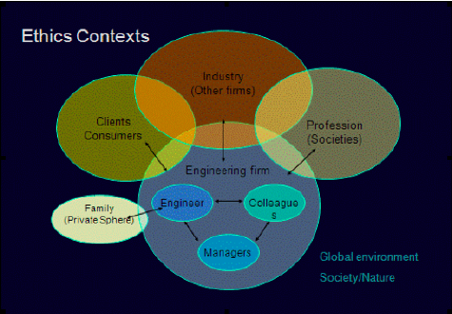
Contexts for professional ethics.

Slide 41
“Ethics” we refer to particular set of attitudes, values, beliefs and habits displayed by a person or a group.
“Mores” the Latin root of “morals.” Thus, the term “Ethics” is derived from Ethos (Greek) and “Morality” is derived from Mores (Latin).
” Ethics is defined as the study of morality, which raises two questions: (a) what is morality? and (b) what is the study of morality? Morality can be defined as: a system of rules for guiding human conduct, and principles for evaluating those rules.

Slide 42
Although the two words have the same origins as their noun counterparts, there are nuances in connotations that are probably more easily found in the adjectival forms. While “moral” as a rule refers to privately virtuous conduct, “ethical” is used when referring to professional conduct.
Ethical misdeeds are actions that lead to prosecution in civil court, while moral misdeeds usually call to criminal court.

Slide 43
Ethical Hackers: Good Guys in Bad Land
Actually, the combination of the two words “ethical” and “hacker” itself is weird because one may wonder what is “ethical” about “hacking.”
suppose an ethical hacker ﬁnds certain vulnerabilities in the software developed or website designed for an organization that has hired the ethical hacker.
After waiting for a requisite time, the hacker does not get any response from the organization indicating their action plan and date for closing the gap found (i.e., vulnerability), then in the interest of getting the gap closed, should the ethical hacker throw open the known vulnerability to the public hoping that some third party may oﬀer a solution to close the vulnerability?
This is indeed an ethical issue because by making it known to the “public,” as much as the “good guys” acting on it, the hacker community also becomes aware of the weakness/vulnerability and they may as well make plans to exploit that vulnerability

Slide 44
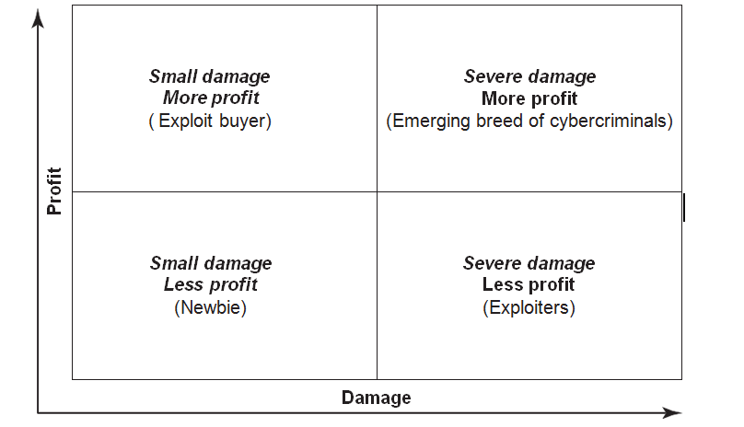
Hackers Motives(Profit and damage)

Slide 45
Ethics is one aspect of practical philosophy to explain how professionals in computing domain should make decisions about professional and social behavior. Ethics is a set of moral principles that govern the behavior of a group or individual.
Computer ethics is set of moral principles that control the use of computers. Some common issues of computer ethics include intellectual property rights (such as copyrighted electronic content), privacy concerns and how computers affect society

Slide 46
The 10 commandments of computer ethics
Not use a computer to harm other people;
Not interfere with other people’s computer work;
Not snoop around in other people’s computer files;
Not use a computer to steal;
Not use a computer to bear false witness;
Not copy or use proprietary software for which you have not paid;
Not use other people’s computer resources without authorization or proper compensation;
Not appropriate other people’s intellectual output;
Think about the social consequences of the program you are writing or the system you are designing;
Always use a computer in ways that insure consideration and respect for your fellow humans.

Slide 47
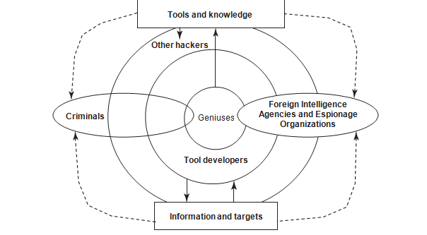
The Psychology, Mindset and Skills of Hackers and Other Cybercriminals

Slide 48
Inside the Minds and Shoes of Hackers and Cybercriminals
The basic motives behind web attacks and hacking are: (a) money, (b) freedom, (c) love, (d) personal gain
a) Money as the motive: Majority of hackers get into cybercrime for monetary gain. Money is the primary motivation behind cybercrime whether it is stealing people’s bank account information, fraudulently obtaining money or property by altering computerized information.

Slide 49
b) Freedom as the motive: Many hackers believe that the Internet should be free and that all computers should be completely accessible. They could also have a political or social agenda where their aim is to damage high-proﬁle computers to make a gain. Ex: Defacement and DOS attacks
c) Love as the motive: This sounds wonderful and it is also one of the motives. Being in love has prospered many and being in love has destroyed many. This example is mentioned here only to illustrate the point about “being cheated” in love or relationship, acting as a motive to hack
d.Personal gain as the motive: In hacker community, a “script kiddie” or “skiddie” is often assumed to be a juvenile using script developed by others to attack computer systems and networks either to impress friends or gain credit in computer-enthusiast communities.

Slide 50
Hackers and Cybercriminals: Evolution of Technical Prowess and Skills
“Black Hat Hacker” and “White Hat Hacker”
There are also “generations of hackers.” For example, the ﬁrst generation in 1960s was the creative programmer breed. They employed novel methods for program- ming, known as code bumming.
The second generation in 1970s was termed as the computer evolutionary generation. (software Piracy)
The third generation in 1980s was the games and copyright breakers. They enjoyed developing methods for protecting and breaking copyright codes on games.
The 1990s saw the rise of fourth generation – the criminals and cyberpunks. Hackers of this generation are criminally oriented and motivated primarily by greed, power, revenge, malicious intent

Slide 51
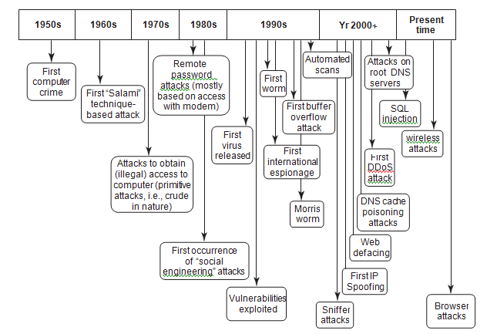
Sophistication of hacker attacks.

Slide 52
This studious community called “hackers” is a technologically advanced community;
Hackers tools are of two types:
(a) Reconnaissance tools. Reconnaissance often begins with searches of Internet databases including Domain Name System (DNS) registries, databases, Google, online news sources, business postings and many other online resources
(b) Exploitation tools are used to verify that an actual vulnerability exists by exploiting it. It is one thing to have vulnerability testing software or banners indicating the possibility of an exploitable service, but quite another to exploit that vulnerability.

Slide 53
